Slide 1
Functional Interaction Transfer from Human to Robot
We do not transfer human actions.
We transfer the functional interaction realized by human actions,
and let each robot embodiment synthesize its own actions to realize the same interaction.
LHY
2026.8.15

Slide 2
Human Experience
Shared Task Knowledge
Robot Action
A: What to be extracted?
B: How to transfer across embodiments？
① Action
② Effect
③ Interaction

Slide 3
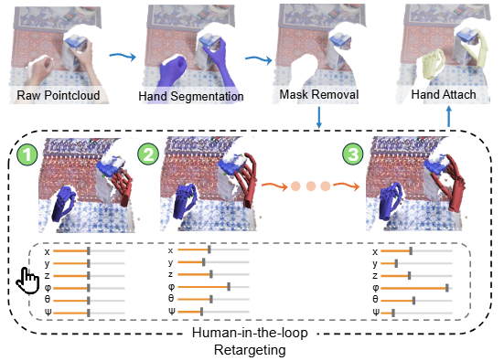
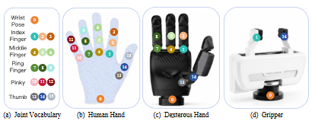
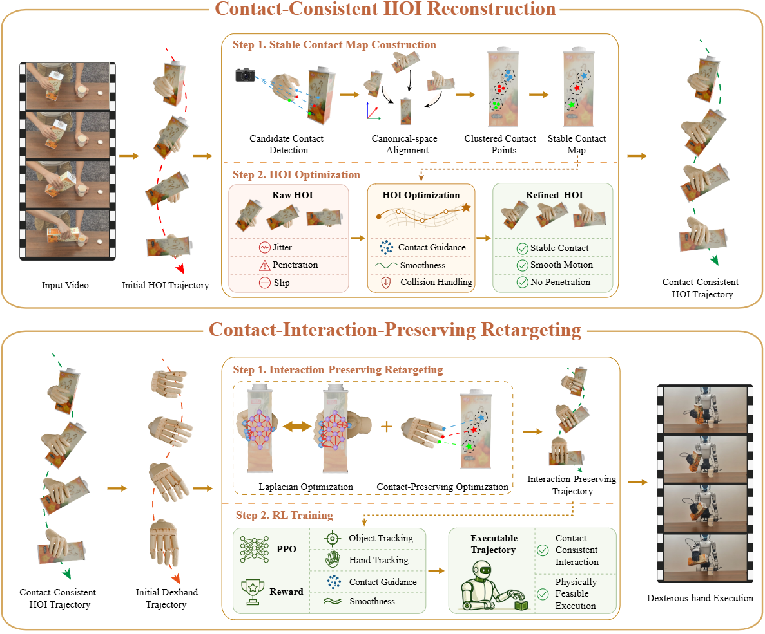
Action
·UniDex
Human-in-the-Loop retargeting
·AdvDex
Joint-aligned Action Space
·C2Dex
Human Video –> 恢复hand-object trajectory –> 稳定object-side contacts –> 接触约束retarget

Slide 4
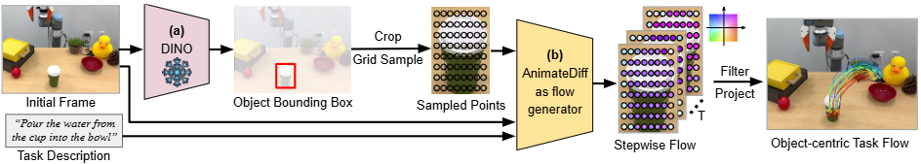
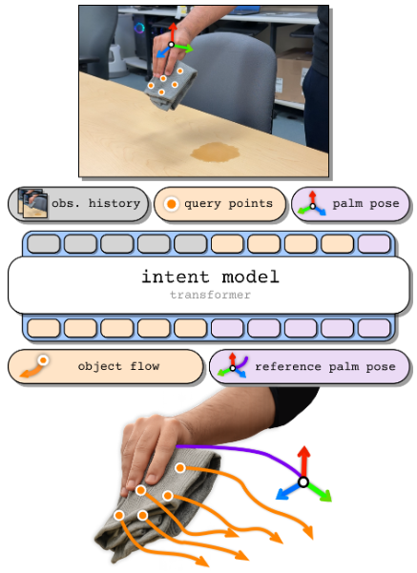
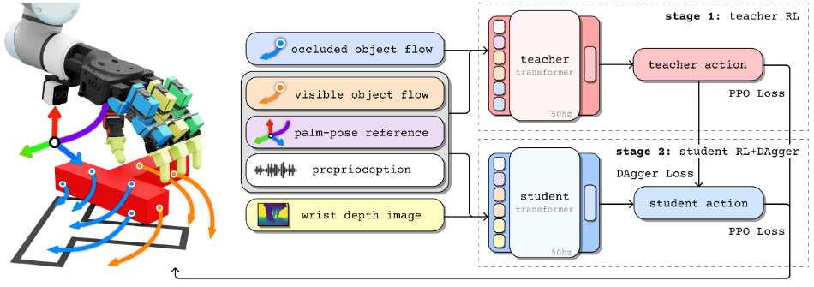
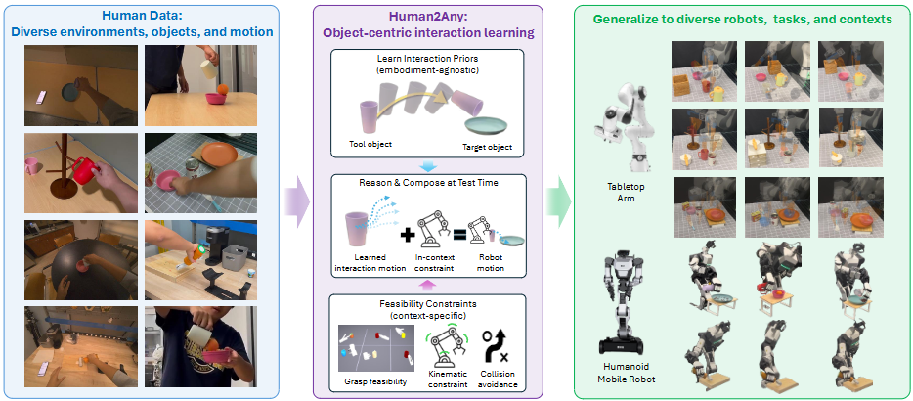
Effect
·Im2Flow2Act
Human Video: scene –> object flow ; Robot Sim Play Data: desired flow –> robot action
·LUCID
Object flow + Palm pose
·Human2Any
Tool & Target Object relative motion + constraint rules

Slide 5
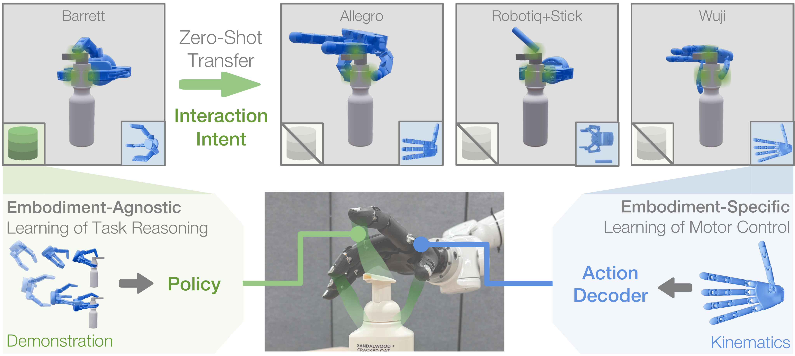
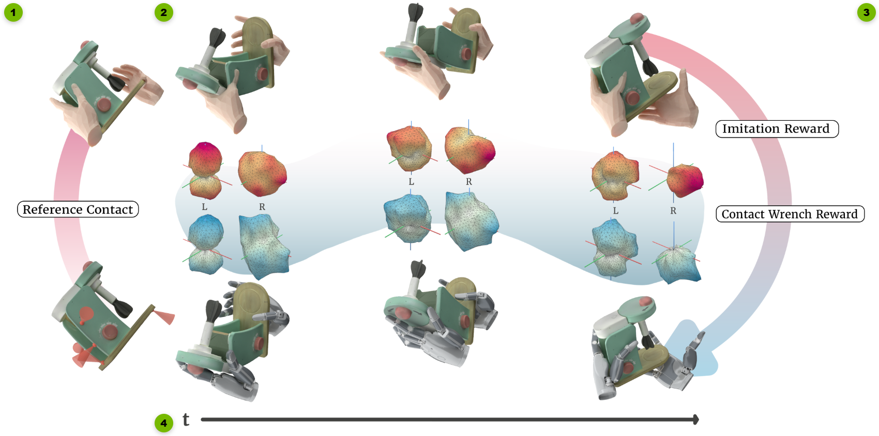
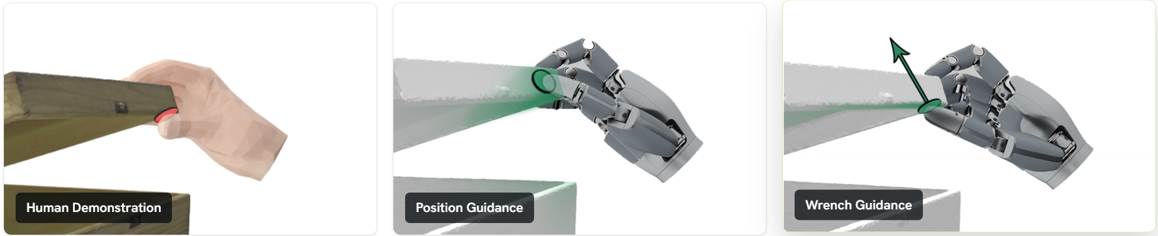
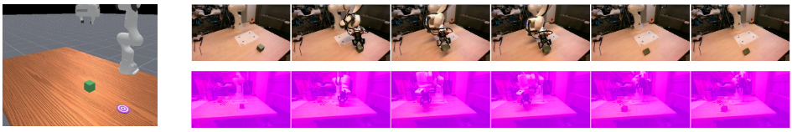
Interaction
·KITE
Spatial Engaging Area + Direction –> Policy ; URDF –> interaction intent –> Decoder
·CHORD
Contact Wrench Space (each task needs a specialized RL Policy)
·ContactFlow
3D Contact Point Trajectory –> World Model –> Future Outcome

Slide 6
Human Experience
Shared Task Knowledge
Robot Action
A: What to be extracted?
B: How to transfer across embodiments？
① Action
② Effect
③ Interaction

Slide 7
A: What to be extracted?
Ⅰ. Human Interaction Acquisition
(1) How the world changes next?
First-Person Vision (RGB-D / …)
(2) Which regions participate in the interaction?
Tactile Sensor (Multimodal & Thin)
(3) What type of interaction occurs?
(4) What contact states are they in?
Surface Pose Sensor<to be tackled>
(5) Are there any referential constraints?
No need for human hand poses / skeleton, just focus on interaction surfaces

Slide 8
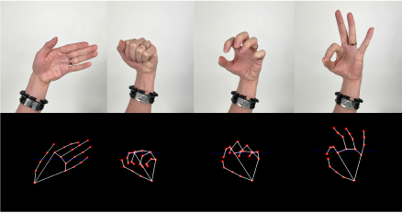
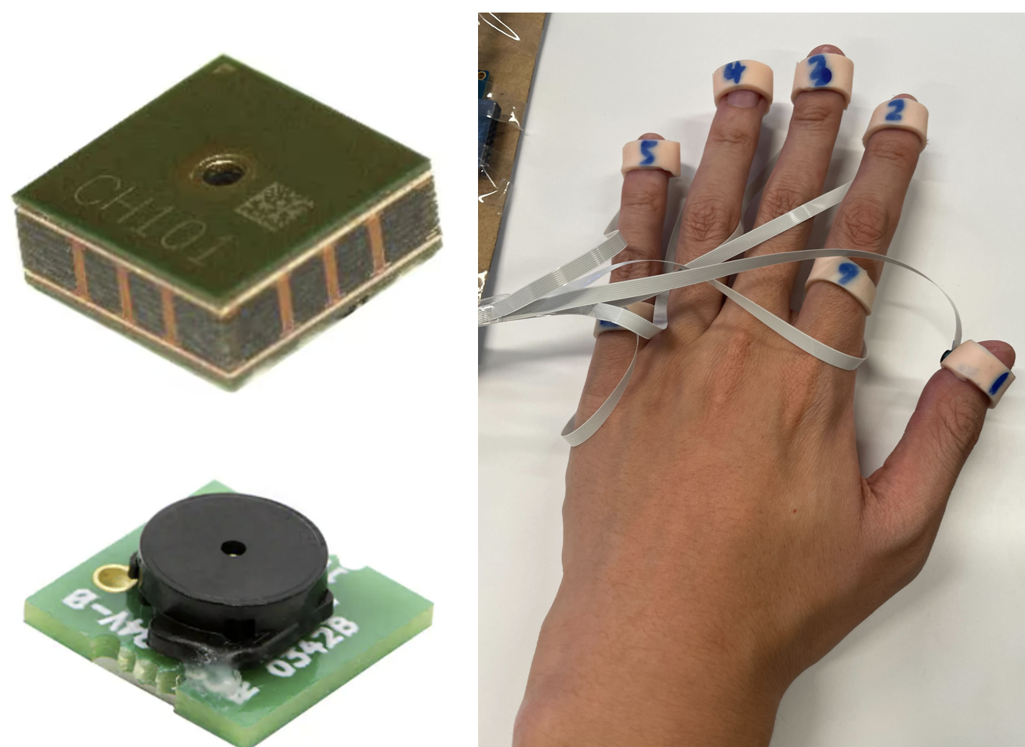
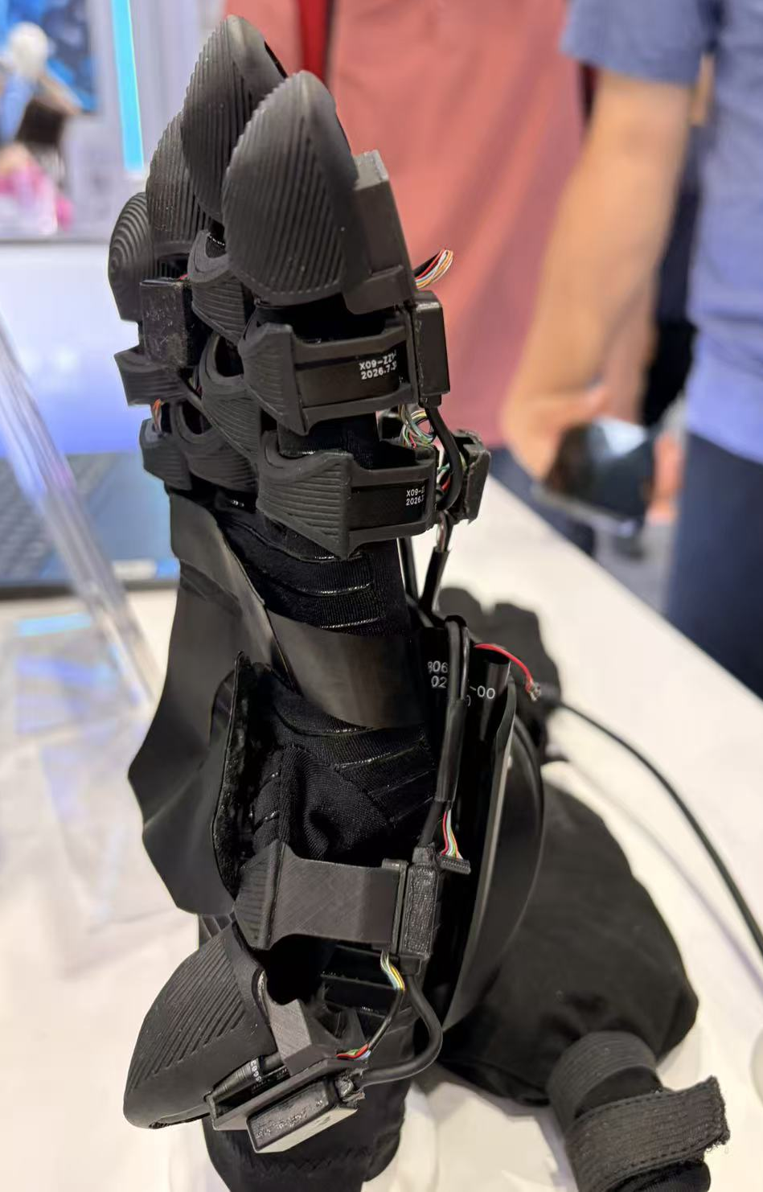
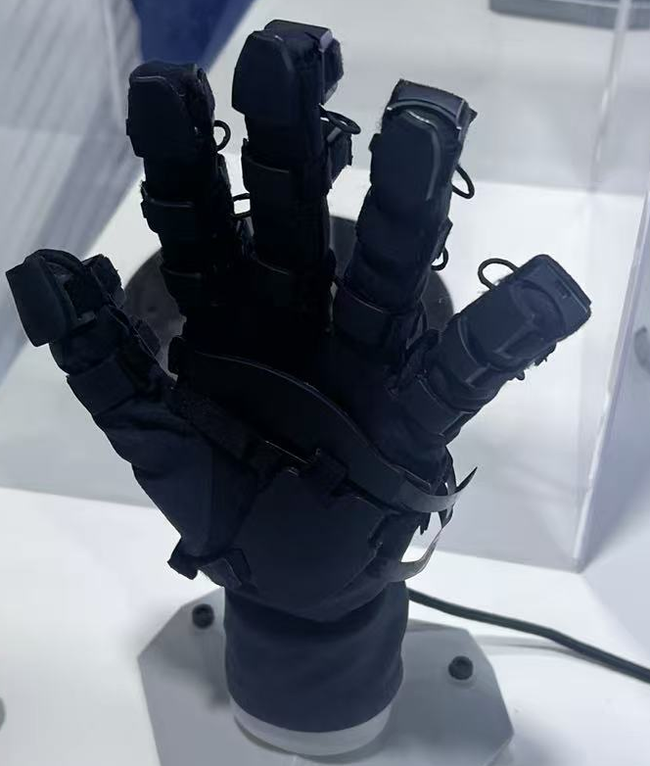
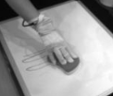
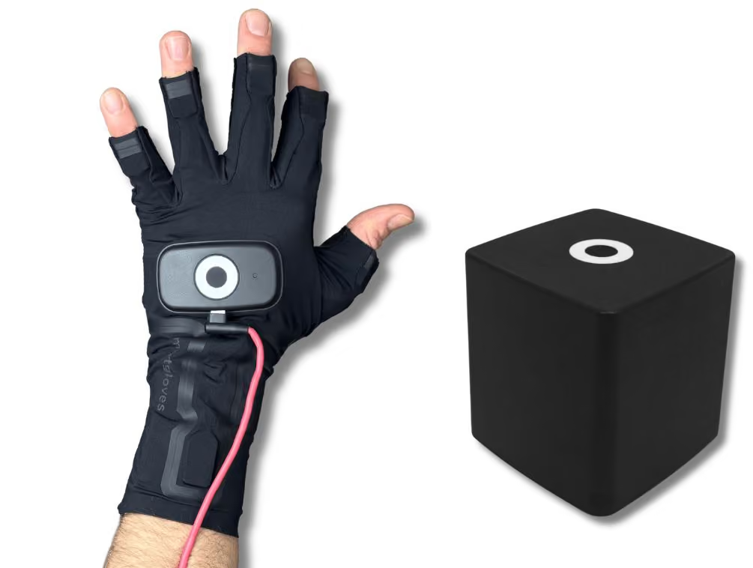
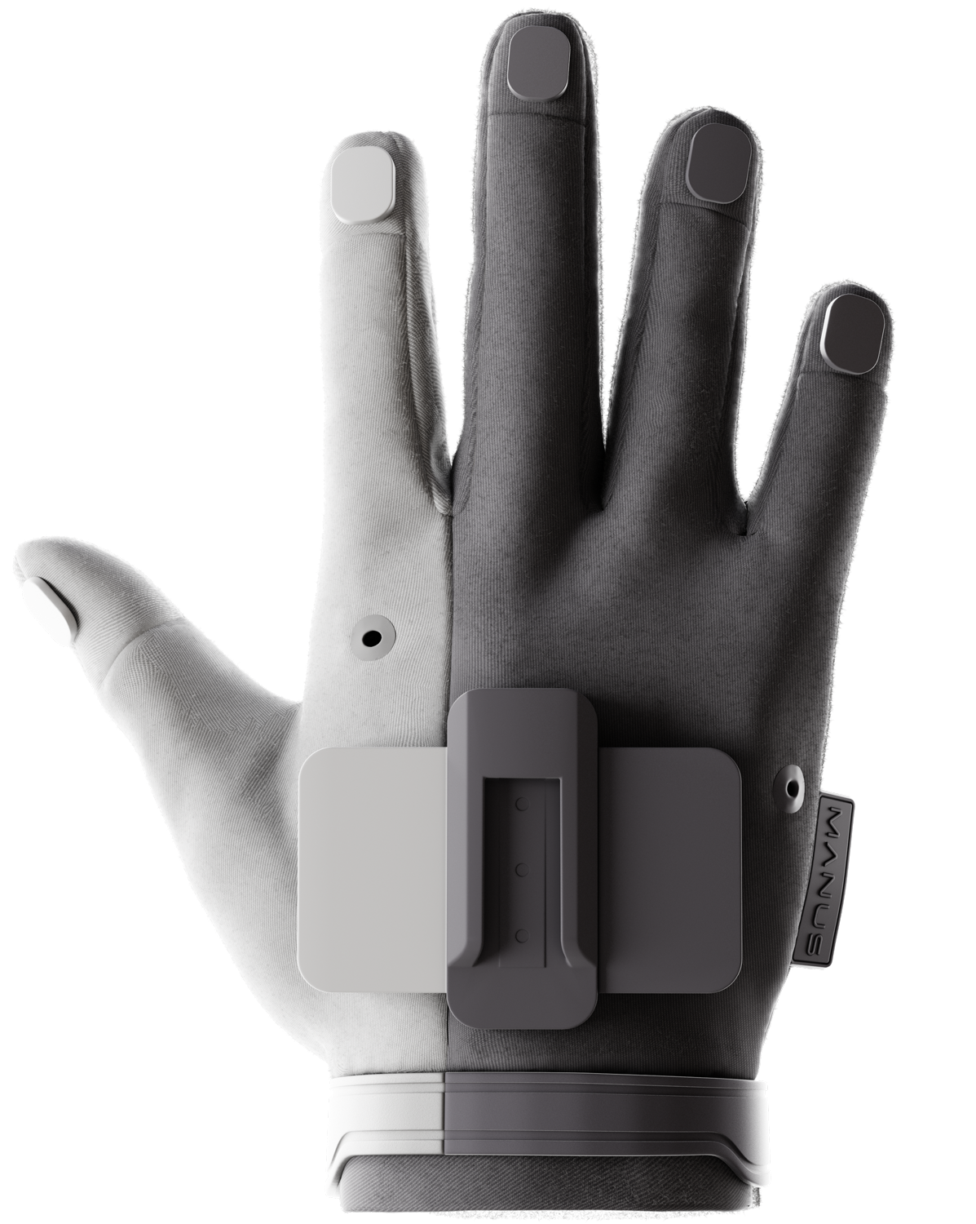
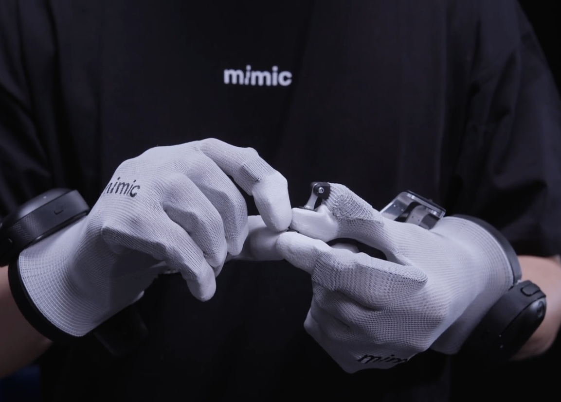
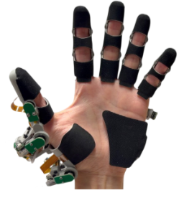
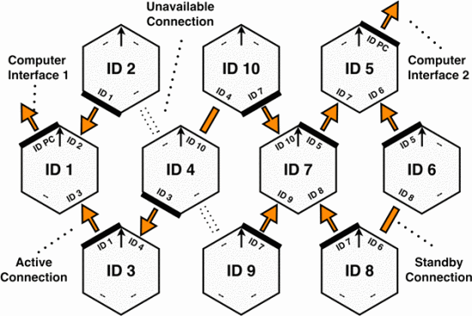
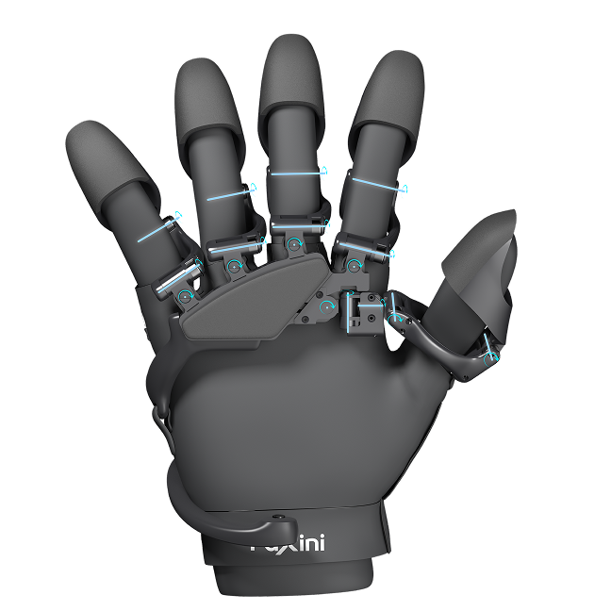
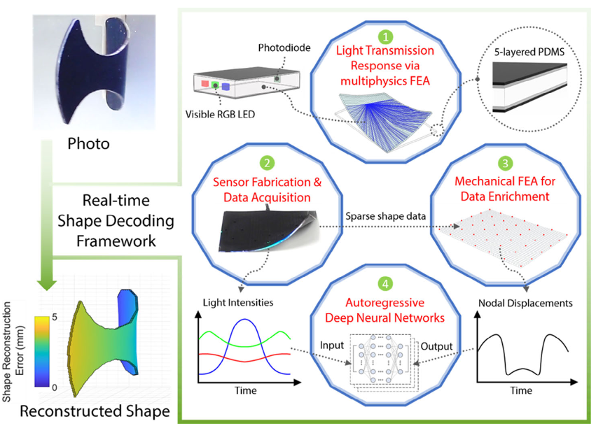
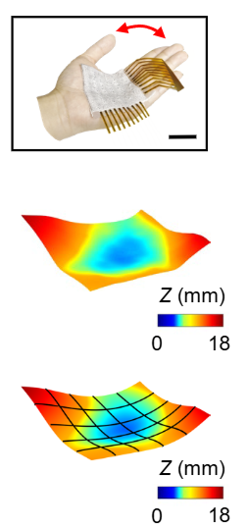
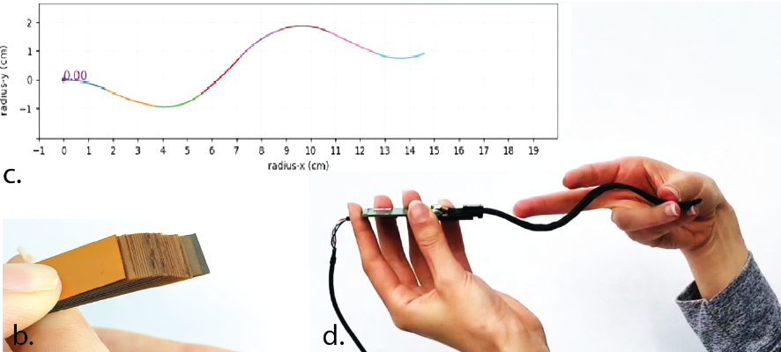
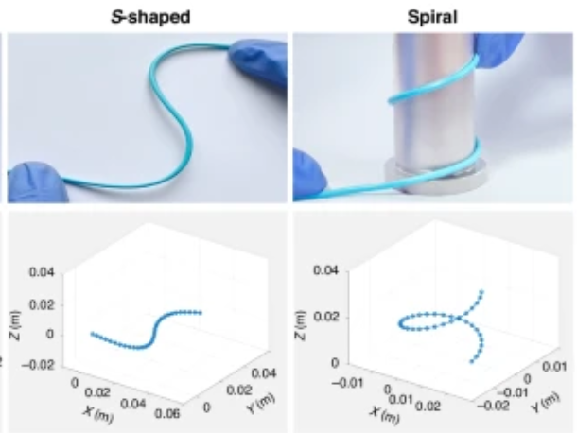
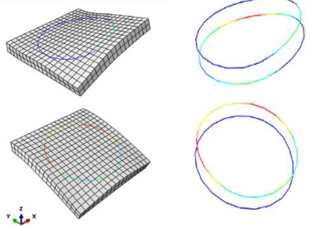
A: What to be extracted?
Ⅰ. Human Interaction Acquisition
Pose Only
Pose & Geometry
Outer Field
Mechanical
Constraint
Self-Aware Soft
Constraint

Slide 9
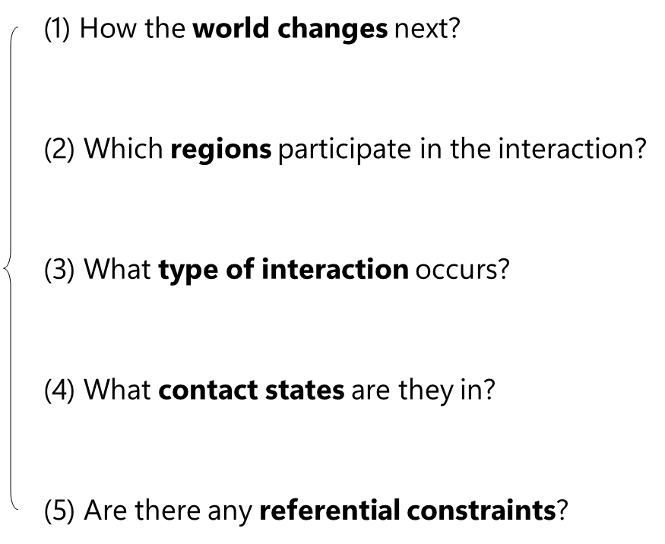
A→B: Bridging
Ⅱ. Functional Interaction Learning
Different people do the same thing differently. So we need to find the shared task structure.
We train a model that predicts the future interaction with a universal representation.

Slide 10
B: How to transfer across embodiments?
Ⅲ. Embodiment Executor
We build a generic embodiment executor to adapt diverse end-effectors.
Embodiment Planner : sampling, IK, collision checking, reachability, contact mechanics…
Generic Interaction Executor : Simulation / Real-World RL –> “Action Decoder”

